Slide 1
Codes on Random Geometric Graphs Dejan Vukobratović Associate Professor, DEET-UNS University of Novi Sad, Serbia Joint work with D. Bajović, D. Jakovetić, V. Crnojević (UNS)

Slide 2
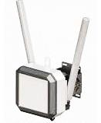
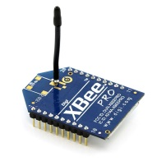
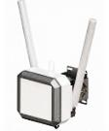
Codes on Random Geometric Graphs
Small Base Station
Sensor Node

Slide 3
Codes on Random Geometric Graphs

Slide 4
Codes on Random Geometric Graphs

Slide 5
This talk will be about…
Inspiration: Codes on graphs
LDPC codes and iterative decoding methods
Problem: Massive uncoordinated multiple access
Evolution of Slotted ALOHA protocols
Motivation: M2M services in future 5G
Connecting massive amount of devices to future 5G small cell network

Slide 6
Outline
Single Base-Station Model
Recent Trends in Slotted ALOHA
LDPC Codes
Multiple Base-Station Model
Cooperative Slotted ALOHA
Codes on Random Geometric Graphs
Summary

Slide 7
Outline
Single Base-Station Model
Recent Trends in Slotted ALOHA
LDPC Codes
Multiple Base-Station Model
Cooperative Slotted ALOHA
Codes on Random Geometric Graphs
Summary

Slide 8
Slotted ALOHA
n users
Preliminaries
$n$ system users
Each user wants to send a packet over shared channel
Time is divided in slots
Users are synchronized to slots
Slotted ALOHA rules:
Fully distributed, no coordination
Every user applies the same rule:
If a user has a packet to send, it will send it in upcoming slot
. . .
. . .

Slide 9
Slotted ALOHA
n users
SA protocol
Users access slots with slot-access probability $p$
Average slot load $G=p∙n$
Idle slots are waste
Singletons are useful
Collisions are destructive
Throughput:
Average fraction of singletons: $T=Ge^{−G}$
$T_{max}=\frac{1}{e}≈0.37$ (when $G=1$)
. . .
. . .
L. G. Roberts, “Aloha packet system with and without slots and capture,” SIGCOMM Computer Communications Review, Apr. 1975.

Slide 10
Framed Slotted ALOHA
n users
FSA protocol
τ slots
Slots are organized in frames
If a user has a packet to send, it will send in upcoming frame in a randomly selected slot
Average load is $G=\frac{n}{\text{τ}}$
Throughput:
Average fraction of singletons: $T=Ge^{−G}$
$T_{max}=\frac{1}{e}≈0.37$ (when $G=1$)
Frame
. . .
. . .
H. Okada, Y. Igarashi, Y. Nakanishi, ”Analysis and application of framed ALOHA channel in satellite packet switching networks”, Electronics and Communications, 1977.

Slide 11
Collision Resolution Diversity Slotted ALOHA
n users
CRD-SA protocol
τ slots
Users repeat transmissions in multiple slots
Repetition information in packet header
Same number of repetitions per user
Collisions can be exploited
Iterative interference cancellation across slots
Throughput:
$T≈0.55$ for CRDSA with two repetitions per user
Frame
. . .
. . .
E. Casini, R. De Gaudenzi, O. del Rio Herrero, “Contention Resolution Diversity Slotted ALOHA: An Enhanced Random Access Scheme for Satellite Access Packet Networks”, IEEE Trans Wireless Comms, April 2007.

Slide 12
Collision Resolution Diversity Slotted ALOHA
n users
Iterative Interference Cancellation (IIC)
τ slots
Once the frame is finished, the base station performs IIC across time slots
Iterative Interference Cancellation:
Detect and decode clean signal (singleton)
Remove its contribution from other slots
Repeat while possible
Frame
. . .
. . .
. . .
Recovery failure: Stopping Set!
Complete recovery: Graph Erased
. . .
E. Casini, R. De Gaudenzi, O. del Rio Herrero, “Contention Resolution Diversity Slotted ALOHA: An Enhanced Random Access Scheme for Satellite Access Packet Networks”, IEEE Trans Wireless Comms, April 2007.

Slide 13
Irregular Repetition Slotted ALOHA
n users
τ slots
IRSA protocol
slot degree $|s|$
user degree $|d|$
Iterative interference cancellation equivalent to iterative erasure decoding of LDPC codes
Improved design (generalization of CRDSA)
No. of repetitions varies across users
Every user selects its no. of repeated transmissions (degree d) according to a predefined degree distribution $Λ_{d}$
There exists an asymptotic threshold load G* below which probability user is collected $→1$
G* ~ 0.97
Frame
. . .
. . .
G. Liva, “Graph-Based Analysis and Optimization of Contention Resolution Diversity Slotted ALOHA,” IEEE Transactions on Communications, February 2011.

Slide 14
Frameless ALOHA
n users
Frameless ALOHA
p
p
p
p
Idea: Apply paradigm of rateless codes
No predefined frame length
Slots are successively added until sufficiently many users are resolved
Optimization of the slot degree distribution
Implicitly controlled through user behavior - slot access probability p
p
p
p
p
p
p
p
. . .
p
p
p
p
. . .
. . .
p
p
p
p
p
C. Stefanovic, P. Popovski, D. Vukobratovic, “Frameless ALOHA Protocol for Wireless Networks”, IEEE Communication Letters, December 2012.

Slide 15
SA vs LDPC
Slotted ALOHA
Modeled as LDPC codes for erasure channels
Goal: Max Throughput: T = G P_{dec}
Decoding Probability Analysis
. . .
Asymptotic analysis
Density Evolution
Finite-Length analysis
Stopping Sets
. . .
E.Paolini, C. Stefanovic, G. Liva, P. Popovski, “Coded Random Access: How Coding Theory Helps to Build Random Access Protocols”, IEEE Communications Magazine, to appear, arxiv.org/abs/1405.4127

Slide 16
Outline
Single Base-Station Model
Recent Trends in Slotted ALOHA
LDPC Codes
Multiple Base-Station Model
Cooperative Slotted ALOHA
Codes on Random Geometric Graphs
Summary

Slide 17
Multiple Base Station Model
Small Base Station
Sensor Node

Slide 18
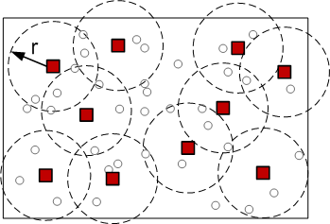
System model
Base station deployment, user locations
n users/devices, m base stations…
Base station
User/Device
…deployed independently uniformly at random over unit square area.

Slide 19
System model
Transmission protocol
Run slotted ALOHA in parallel across all BS
$τ$ slots per frame – slot synchronized across all base stations
User may be active (send packet replica) in several slots per frame
User is heard by all base stations that cover it

Slide 20
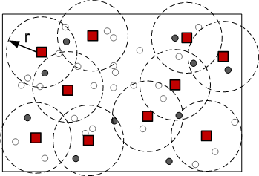
System model
System snapshot at slot t = 4
Base station
User active at t
User inactive at t
Signal at the base station j at slot t:
sum of signals of all users active at slot t covered by the base station j

Slide 21
System model
User collection
Base station “collects” a user whenever it detects a “clean” signal
A user is collected if it is collected by any base station!
(t = 4)
User 2 decoded!

Slide 22
Asymptotic analysis
Asymptotic setup
$n, m\left(n\right), τ\left(n\right)→ ∞$ and $r\left(n\right)→$ 0
$δ,G>0,$ where$δ= r^{2}π∙m$ and $G=n/(mτ)$
Probability of user collection: $P\left(U_{i} coll.\right)=E\left[\frac{1}{n}\sum_{i=1}^{n}{I\left\{U_{i} coll.\right\}}\right]$
Upper bounded by user coverage probability $1−e^{−δ}$
Normalized throughput: $T\left(G\right)=\frac{1}{mτ}E\left[\sum_{i=1}^{n}{I\left\{U_{i} coll.\right\}}\right]=G∙P\left(U_{i} coll.\right)$
Threshold Load: $G^{∗}\left(δ\right)=sup⁡\{G≥0:P\left(U_{i} coll.\right) →1−e^{−δ}\}$
Metrics of interest

Slide 23
Decoding via Spatial Cooperation
Performed on a slot-by-slot basis

Slide 24
Decoding via Spatial Cooperation
Spatial Cooperation decoding algorithm
One iteration at arbitrary base station after each slot t
1) Check signal : BS j checks whether its received signal y_{j,t} corresponds to a singleton; If yes, it performs Collect & Transmit step, otherwise it performs Receive & Update step
2) Collect & Transmit: BS j collects a user u and transmits x_{u} to all BS k adjacent to user u (this is known to BS in advance). BS j leaves the algorithm.
3) Receive & Update: BS j scans all the received messages from its neighbors and identifies distinct set of user signals x_{u}. Then it removes all the signals from this set from y_{j,t} and goes to step one in the next iteration
Fully Distributed: base stations communicate only with neighboring base stations!

Slide 25
Main results
Spatial Cooperation:
[Upper Bound on $P\left(U_{i} coll.\right)]$: $P\left(U_{i} coll.\right)≤1−e^{−δ}−\left(1−e^{{−δ}/4}\right)e^{−2δ}\left(1−e^{{−Gδ}/4}\right)$
[Threshold Load]: $G^{∗}\left(δ\right)=0$
The probability $P\left(U_{i} coll.\right)$ decreases at G = 0 from the value $1−e^{−δ}$ with negative slope equal at least $\frac{δ}{4}\left(1−e^{{−δ}/4}\right)e^{−2δ}$
[Peak throughput scaling compared to single BS]:
$1− ε$ coverage
Throughput ≥ $\frac{1− ε}{ln⁡(1/ε)}$ x $m$ x throughput of single-BS frame slotted ALOHA

Slide 26
Decoding via Spatio-Temporal Cooperation
Performed on a frame-by-frame basis
Each base station is doing:
1) Temporal decoding
2) Spatial decoding
Interchangeably…

Slide 27
Decoding via Spatio-Temporal Cooperation
Spatio-Temporal Cooperation decoding algorithm
One iteration at arbitrary base station after each frame of τ slots
1) Temporal SIC and Transmit: BS j performs Temporal SIC across its received slots within the frame. The set of recovered users is shared with neighboring BS’s and BS j goes to next step
2) Check Termination: If all the slots are recovered , BS j leaves the algorithm
3) Receive and Spatial IC: BS j scans all the received messages from its neighbors and identifies distinct set of yet unrecovered user signals x_{u}. Then it removes all the signals from this set from all the slots where these users were active (activation slots are known for collected users) and goes to step one in the next iteration
Fully Distributed: base stations communicate only with neighboring base stations!

Slide 28
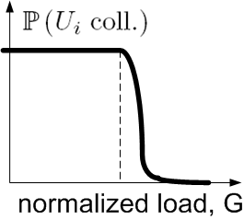
Main results
Spatio-Temporal Cooperation:
[Lower Bound on $P\left(U_{i} coll.\right)]$ : $P\left(U_{i} coll.\right)≥1−e^{−δ}−P_{S}(H=4δG)$
[Threshold Load]: $G^{∗}\left(δ\right)≥\frac{1}{4}\frac{H^{∗}}{δ}$
The probability $P\left(U_{i} coll.\right)$ stays at the maximum value $1−e^{−δ}$ at least in the range [0, $\frac{1}{4}\frac{H^{∗}}{δ}$]
[Peak throughput scaling compared to single BS w iterative IC]
$1− ε$ coverage
Throughput ≥ $\frac{1}{4}\frac{1− ε}{ln⁡(1/ε)}$ x $m$ x throughput of single-BS frame slotted ALOHA with iterative interference cancellation

Slide 29
Optimal user degree distributions
Close to
single-BS optimal (IRSA)
Close to
constant-degree-two distribution
— average users’ spatial degree

Slide 30
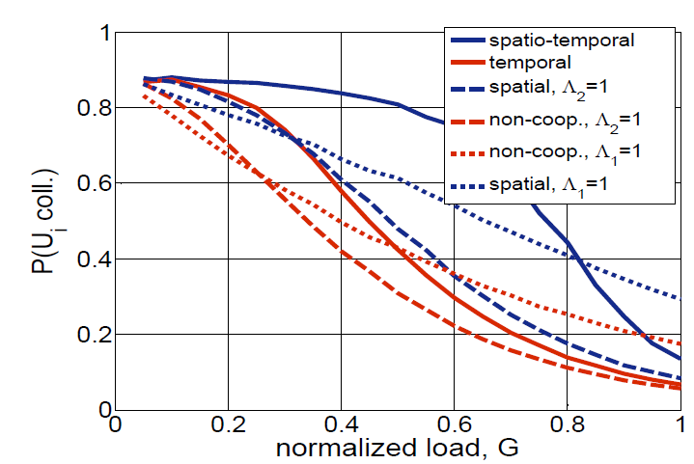
Simulation results
$$δ=2.5$$

Slide 31
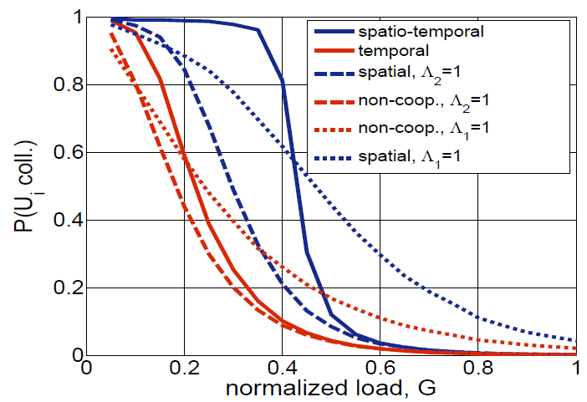
Simulation results
$$δ=8$$

Slide 32
Summary
(Modern) coding theory helps designing efficient ALOHA-based random access protocols for single base station
For multiple base stations, geographic constrains need to considered, leading to codes on random geometric graphs
Work in progress, some results already available:
[Bajović, Jakovetić, Vukobratović & Crnojević, IEEE ICC 2014]
http://arxiv.org/abs/1401.6799
[Jakovetić, Bajović , Vukobratović & Crnojević, IEEE ISIT 2014]
http://arxiv.org/abs/1401.6810
[Jakovetić, Bajović, Vukobratović & Crnojević, IEEE Transactions on Communications, – to appear]
http://arxiv.org/abs/1407.1109

